Slide 1
Brick Smash: A Classic Java Arcade Game
(1BF24CS137)
Madhav V Nair (1BF24CS159), Asif (1BM25CS420) ,Madhireddy Sathvik Reddy (1BF24CS160)

Slide 2
Problem Statement :-
To design and implement a Java-based Brick Breaker game that uses keyboard controls, real-time graphics, and collision detection to break bricks, track score, and determine game over conditions using object-oriented programming principles.

Slide 3
Introduction
Brick Breaker is a classic 2D arcade game developed using Java. The game involves controlling a paddle to bounce a ball and break bricks, demonstrating the use of Java graphics, event handling, and object-oriented programming concepts.

Slide 4
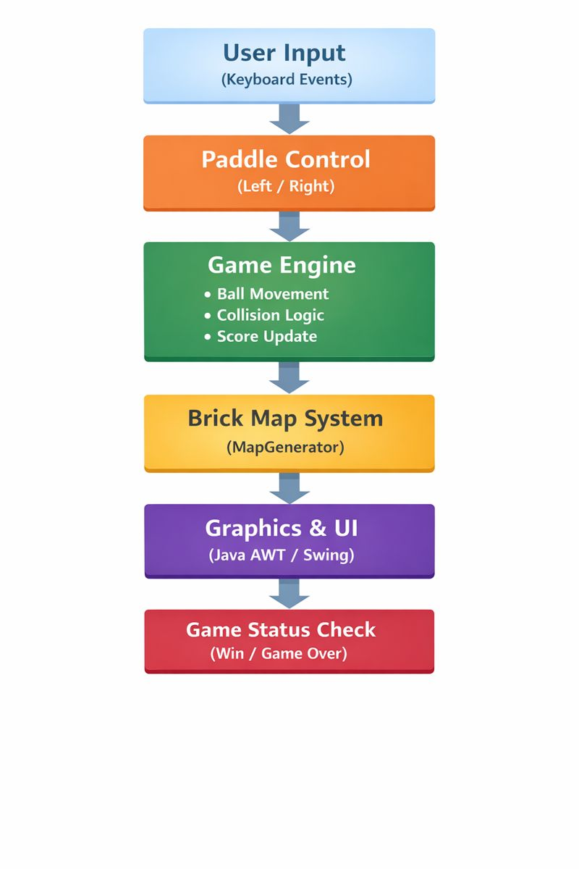
Overview of the project
Block Diagram !

Slide 5
Tools used
Java Programming Language
Code Editor / IDE: Visual Studio Code (VS Code)
Java Development Kit (JDK): JDK 8 or above
GUI Toolkit: Java AWT (Abstract Window Toolkit)
Framework: Java Swing
Input Handling: Keyboard Event Listener
Graphics Rendering: Java Graphics Class
Operating System: Windows

Slide 6
OOJ Concepts Used
Class and Object
Encapsulation
Abstraction
Inheritance
Polymorphism
Event Handling

Slide 7
Results

Slide 8
Thank you ……..

